Slide 1
Woodside Parent Faculty Club (PFC) Meeting
January 25th, 2022

Slide 2
Agenda
Woodside PFC Welcome and approval of 12_14_21 meeting minutes
Principal Alvarez Updates
Budget Review
Review of Upcoming PFC Sponsored Events
Updates from Closed Board Session
Updates from the Science Lab

Slide 3
Open PFC Positions
VICE PRESIDENT: Support the President and all Board Members in their duties
Support the President in all defined roles
Manages the PFC Membership drive and works with the Secretary to keep the email account
and communications information up to date and accurate.
Liaison for all fundraising activities, as needed
Manage Calendar of activities
Perform duties of the President in their absence
Committee Chair(s): Coordinate specific fundraising events with co-chairs (if available)
Be responsible and take ownership of all planning, coordination and execution of a specific fundraising event
Coordinating volunteers before and during the event
Provide updates to PFC any issues or needs to support a specific event (i.e more supplies, volunteers, donations etc..)

Slide 4
Principal Updates:
COVID Updates (Notifications, tables/umbrellas, COVID website)
School Safety (cones, back gate area)
Field Trips (5th grade in particular)
Incident on campus

Slide 5
Budget Review
[SEE WEBSITE]

Slide 6
Review Upcoming PFC Events
Feb. 28th-March 13th
March 24th – March 31st

Slide 7
Outcome of Closed Board Meeting (Jan. 19th, 2022)
The board decided to cancel the annual Auction this year
The PFC will purchase a few vinyl signs for the major annual events to be placed near the kinder/TK yard
for better event communication
Approval from Principal Alvarez to use the bulletin board near the Kinder/TK area to try to draw more
attention to events/notices/updates
Teacher appreciation week is being planned---will require help from each teacher to identify a room parent
or a group parents to help us in our secret endeavor to show our teachers how much we appreciate
them. Will coordinate in with the teacher appreciation lunch ☺ More to come…

Slide 8
Science Lab
“It has been a long ride, but we are finally back in the science lab! I am so excited to once again be in the lab and be a part of creating a love of science and curiosity for your children. Thank you for this awesome opportunity.”
“My goal as we go through the rest of the semester and the different sciences is to help each child’s curiosity and understanding grow, and bring them up to grade level in science. To help achieve this, I am looking at the Science standards for each grade level and planning lessons and experiments that fit within those standards using a combination of different platforms such as Generation Genius, Mystery Science, Education in Engineering, Mark Rober, and the Internet.”
“In the lab we go through a lot of supplies, and many of them are dwindling: paper towels and empty paper towel tubes, empty toilet paper tubes, dish soap and hand soap (lots of hand washing happens in science), sanitizing wipes, cotton balls, cornstarch, balloons, toothpicks, craft sticks, even the trays and bowls that grocery stores use for meat and vegetables, metal pie tins, etc. I can usually find a use for almost anything.”
Check out Ms. Radar’s whole update on www.woodsidepfc.com!!

Slide 9
BACK-UPS

Slide 10
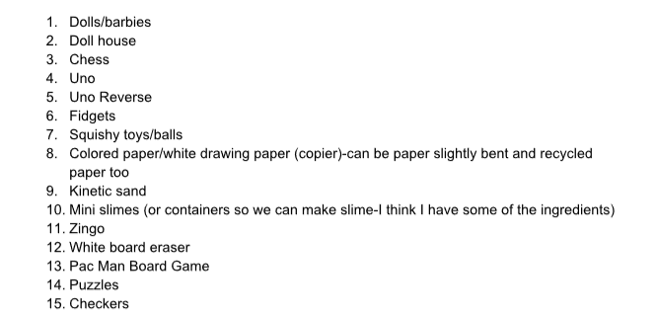
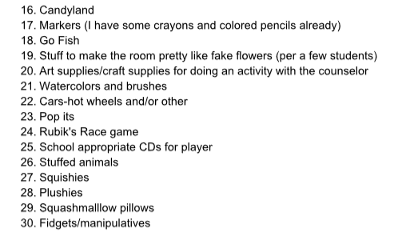
Wolfden Wishlist 2021-2022 Kimber’s Room C-4
Hours of operation: Fridays before school and most recesses, including lunch; some Mondays
Purpose: Alternative free play for students
Needs: (compiled with student input and listed below)
Ongoing replenish: bubbles, chalk, playdoh, dry erase markers
** Used items are great!

Slide 11
Current Status for Events
 | Date/Time | Resources Req. | Volunteers(s) | Committee Chair | PFC Funding | Month
Welcome Back Picnic | Sept. 10th 5:30-7:30pm | Site Permit Informing and advertising | Melissa, Stacy and Laura | None | No (Permit is free)
Fall Fest | Mid/End Oct. | Committee and volunteers Activites (blow-up, games, pumpkin contest etc.) Site Permit | Vanessa Klein Lata Canders Jeff Lee Taryn Degnan | Bridget Peters | Yes
Book Fair | Mid/End Oct. & April/May | Tables/Chairs Permits (?) Scholastic Rep. | Vanessa Klein Ashley Olson Shannon Drury | REQUIRED | Yes (?)
Auction | Spring 2022 | Venue and catering Permits and Liquor License Items for auctioning Decorations Custodial | Jenna Croy Vanessa Klein Lata Canders Stacey Carroll Ashley Olson | REQUIRED | Yes
Lap-A-Thon | October 8th (Pending vendor approval by district) | Music/speakers Water and snack donations Prizes Sponsor donations (water bottles, sports packs) | Jeff Lee | Keri Hallin | Yes
Country Store | Fall/Winter 2021 | Donations for student purchase Tables/chairs Tape, scissors and wrapping paper | Laura Brown | Shannon Drury | No

Slide 12
Current Status for Events (Cont.)
 | Date/Time | Resources Req. | Volunteers(s) | Committee Chair | PFC Funding
Spiritwear | All Year | Vendor for production and distribution | Lacey Elia Haley Olmstead Chiyo Elrod | Keri Hallin | No
PFC Art Program | All Year | Art supplies Tables/Chairs/Permits Family Art Night | Vanessa Klein Lacey Elia Nicole Cleveland | REQUIRED | Yes
Donations | All Year | Flyers and promotional material | Yvonne Philapil | REQUIRED | No
Yearbook Advisor | All Year | Yearbook vendor (Lifetouch) Advertising and flyers | Shannon Drury | None | Yes
Hospitality | All Year | Food etc. to support teacher/staff appreciation events | None | Lacy Rasmussen Emily Merrill | Yes
Dine and Donate | All Year | Forms for participating providers | None | REQUIRED | No
Read-a-Thon | Spring |  | Keri Hallin | Keri Hallin | ??
See’s Candy | Spring |  |  |  | No
Additional Fundraising Events | Multiple times a year | See’s Candy Wrapping paper or other gifts | None | None | No

Slide 13
PFC Upgrades!!
On-boarding a new WoodsidePFC.com website-COMPLETE
Will allow PFC to independently update webpage and on a more frequent basis
More interactive features including donation online, volunteer sign-up online, event coordination online, etc..
Easier to keep updated and relevant documents easy to find
On-boarding a new Teacher Feature on the WoodsidePFC Facebook Page-In-progress
Allow families to get to know all the teachers at Woodside
Give teacher’s an opportunity to highlight classroom needs (volunteer needs (non-covid time) or supplies
Create community with all our teachers regardless of grade level or participation in PFC meetings
Revive the Woodside PFC Twitter Account-COMPLETE
Another avenue to engage with the community
Create more engagement with the Woodside Elementary Twitter
Easy and quick real-time update for events
MORE TO COME SOON……!!!!

Slide 14
PFC- WHO ARE WE??
We are YOU!! We are family members of kids of all ages and grade levels at Woodside. Some of us work full-time outside the home and other work full-time in the home. Most importantly we are all committed to helping support Woodside in providing our kids an enriched and fun learning environment.
How does the PFC support Woodside?
Fundraising events including dine and donates, book fairs, auctions and lap-a-thons
Volunteer hours
Events such as Welcome Back Picnic and Fall Fest
Raising awareness for direct monetary donations supporting PFC or specific efforts such as donorschoose.org
Providing support for computer lab, science lab, student gardens and campus beautification projects
Organizing volunteers to help at school events
How can you help? (our favorite question!!)
Follow the WoodsidePFC Facebook page and attend PFC meetings---we need your ideas and inspiration!
Volunteer to plan, organize or help at events--a little time or a lot of time---on-campus or off---we have options to fit your preference and schedules!
Direct monetary donations to PFC
Help fundraise! Does your company match donations or make donations to local schools?
Supporting teachers’ and staffs’ donorchoose.org campaigns
Engage our communities to bring awareness to our school’s fundraising needs

